Slide 1
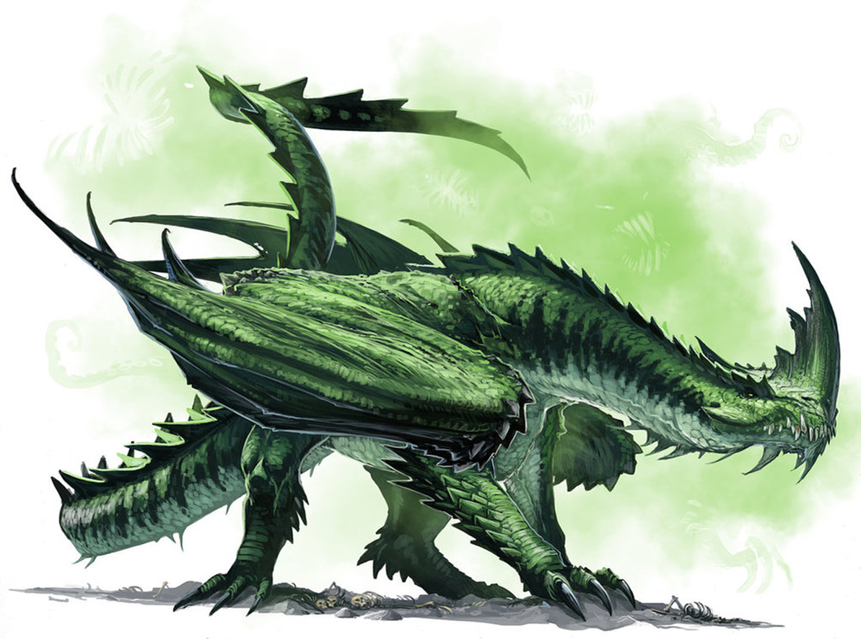
№ 1705 Team “Green Dragon” DIGIT CONSOLE GAME

Slide 2
PROJECT EXPLANATION
The goal is to reorder the given matrix of digits in increasing line (from 0 to 8) by moving the digits with the keyboard arrows. The player should try to reorder the digits by using as few movements as possible.
At the start of the game the player gives his name and chooses the difficulty he wants (easy or hard). The name and movements made by the player are stored and available for viewing. During the game the player can either start new game or quit.

Slide 3
GENERAL REQUIREMENTS
At least 1 multi-dimensional array (public int [,] array for the game board values)
At least 3 one-dimensional arrays(int[] values; scoreList; T[] array)
At least 10 methods (12: static void Main; static public void Choise; static public void Values; static public void Show; static void Ends(ConsoleKeyInfo move); static public void Check; static public void InitializeHard; static public void InitializeEasy; static void Shuffle<T>(T[] array); static public void Keys; public static void ScoreRecords; public static void PrintScores )

Slide 4
At least 3 existing .NET classes (6: System.Collections.Generic; System.Linq; System.Text; System.IO; System.Threading.Tasks; System.Media;)
At least 2 exception handlings (Exeption for invalid key and Exeption for Invalid movement)
At least 1 use of external text file (3: ScoreboardImage.txt; Title.txt and Win.txt)
ADDITIONAL AND OPTIONAL REQUIREMENTS
Git repository: https://github.com/TeamGreenDragon/DigitConsoleGame
Sound effects during the gameplay

Slide 5
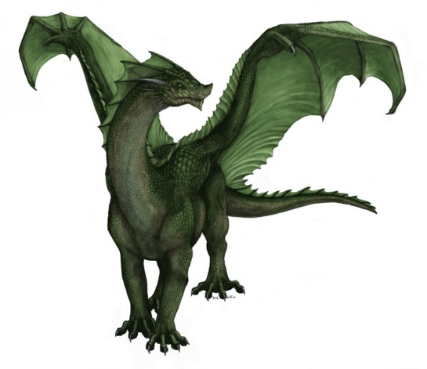
List of team “Green Dragon” members :
Ана Василева (https://github.com/anabogdanova)
Виолета Дамянова (https://github.com/Hmmrpss)
Георги Николов (https://github.com/GeorgiNik)
Огнян Алексиев (https://github.com/oggg)
Петя Мечкова (https://github.com/pmechkova)
Пламен Сухиндолски - AxiL1
Мариета Карастойкова - mary7773
Валентин Макавеев - makeveev

Slide 6

DIGIT CONSOLE GAME =DEMO=

